Slide 1
Bert Imminga Member of the Board AOb until 1-8-2014 Policy advisor ROC van Twente 0031 – 6 12276481 bimminga@rocvantwente.nl

Slide 2
where would we be …
Imagine a world without VET:
http://www.youtube.com/watch?v=DkDDidX8BYo

Slide 3
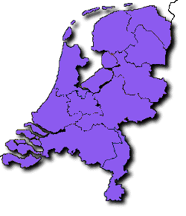
The Netherlands
Amsterdam
Almelo
The Hague
Hengelo
Enschede
Rotterdam

Slide 4
Figures and Facts
Over 2000 faculty and staff circa 25 000 VET-students
circa 12 496 participants Adult Education
0n 3 main campusses in three major cities in Twente and 30 smaller sites in Twente

Slide 5
Dutch Educational System: VET
Actual developments:
Focus on Key competences
Career guidance: reducing ESL
3. Redesign practical training in VET

Slide 6
Dutch Educational System: VET
Actual developments:
4. introduction of Competence-Based Learning: 2010
new (qualifications)structure – documents
also: new didactic approach: Het nieuwe leren
- students: more self responsible
- teachers: not giving but helping to find answers
proces of learning for students and teachers
The struggle of the next generation

Slide 7
Contents
Dutch Educational System
The VET System

Slide 9
Vocational Education & Training and Adult Education
(abbreviated to VET).
(BVE in Dutch)

Slide 10
Qualificationstructure: Levels of qualification
Level 1: assistant training
Notes:
The four levels of qualification in vocational education and related courses
Level 1: carrying out simple practical tasks.
This objective relates to the training of assistants, it lasts between six months and one year, and does not require entrance qualifications. This training programme fulfils the labour market requirement for certificate holders at level one, and offers participants who are unable to obtain an initial qualification the opportunity of joining the labour market as a qualified employee. Progression routes: to basic vocational education.
Level 2: carrying out practical tasks.
This is the basic vocational qualification route that lasts between two and three years, and which does not require entrance requirements either. At this level, the minimum initial qualification must be achieved. Progression routes: to vocational education.
Level 3: carrying out tasks, fully independently.
This relates to a vocational programme which lasts between two and four years, and which according to law may be started by those who have a certificate of pre-vocational education, or a transition certificate to class 4 of senior general secondary education. Progression routes: to middle management training and specialist training.
Level 4: carrying out tasks of a broad or specialist nature, fully independently
Broad professional deployment requires middle management training, which lasts between three and four years. According to law this type of training is open to those who have a certificate of pre-vocational education, or a transition certificate to class 4 of senior general secondary education, or a vocational certificate. Progression routes: to higher education.
Specialisation requires a specialist-training programme, which lasts between one and two years and which can be started by those who have of a vocational training certificate. Progression routes: sometimes to higher education (in certain sectors this level is the highest level that can be achieved).

Slide 11
Levels of qualification
Level 2: basic vocational training
Level 1: assistant training
Notes:
The four levels of qualification in vocational education and related courses
Level 1: carrying out simple practical tasks.
This objective relates to the training of assistants, it lasts between six months and one year, and does not require entrance qualifications. This training programme fulfils the labour market requirement for certificate holders at level one, and offers participants who are unable to obtain an initial qualification the opportunity of joining the labour market as a qualified employee. Progression routes: to basic vocational education.
Level 2: carrying out practical tasks.
This is the basic vocational qualification route that lasts between two and three years, and which does not require entrance requirements either. At this level, the minimum initial qualification must be achieved. Progression routes: to vocational education.
Level 3: carrying out tasks, fully independently.
This relates to a vocational programme which lasts between two and four years, and which according to law may be started by those who have a certificate of pre-vocational education, or a transition certificate to class 4 of senior general secondary education. Progression routes: to middle management training and specialist training.
Level 4: carrying out tasks of a broad or specialist nature, fully independently
Broad professional deployment requires middle management training, which lasts between three and four years. According to law this type of training is open to those who have a certificate of pre-vocational education, or a transition certificate to class 4 of senior general secondary education, or a vocational certificate. Progression routes: to higher education.
Specialisation requires a specialist-training programme, which lasts between one and two years and which can be started by those who have of a vocational training certificate. Progression routes: sometimes to higher education (in certain sectors this level is the highest level that can be achieved).

Slide 12
Levels of qualification
Level 3: full proffessional training
Level 2: basic vocational training
Level 1: assistant training
Notes:
The four levels of qualification in vocational education and related courses
Level 1: carrying out simple practical tasks.
This objective relates to the training of assistants, it lasts between six months and one year, and does not require entrance qualifications. This training programme fulfils the labour market requirement for certificate holders at level one, and offers participants who are unable to obtain an initial qualification the opportunity of joining the labour market as a qualified employee. Progression routes: to basic vocational education.
Level 2: carrying out practical tasks.
This is the basic vocational qualification route that lasts between two and three years, and which does not require entrance requirements either. At this level, the minimum initial qualification must be achieved. Progression routes: to vocational education.
Level 3: carrying out tasks, fully independently.
This relates to a vocational programme which lasts between two and four years, and which according to law may be started by those who have a certificate of pre-vocational education, or a transition certificate to class 4 of senior general secondary education. Progression routes: to middle management training and specialist training.
Level 4: carrying out tasks of a broad or specialist nature, fully independently
Broad professional deployment requires middle management training, which lasts between three and four years. According to law this type of training is open to those who have a certificate of pre-vocational education, or a transition certificate to class 4 of senior general secondary education, or a vocational certificate. Progression routes: to higher education.
Specialisation requires a specialist-training programme, which lasts between one and two years and which can be started by those who have of a vocational training certificate. Progression routes: sometimes to higher education (in certain sectors this level is the highest level that can be achieved).

Slide 13
Levels of qualification
Level 4: middle-management and specialist training
Level 3: full proffessional training
Level 2: basic vocational training
Level 1: assistant training
Notes:
The four levels of qualification in vocational education and related courses
Level 1: carrying out simple practical tasks.
This objective relates to the training of assistants, it lasts between six months and one year, and does not require entrance qualifications. This training programme fulfils the labour market requirement for certificate holders at level one, and offers participants who are unable to obtain an initial qualification the opportunity of joining the labour market as a qualified employee. Progression routes: to basic vocational education.
Level 2: carrying out practical tasks.
This is the basic vocational qualification route that lasts between two and three years, and which does not require entrance requirements either. At this level, the minimum initial qualification must be achieved. Progression routes: to vocational education.
Level 3: carrying out tasks, fully independently.
This relates to a vocational programme which lasts between two and four years, and which according to law may be started by those who have a certificate of pre-vocational education, or a transition certificate to class 4 of senior general secondary education. Progression routes: to middle management training and specialist training.
Level 4: carrying out tasks of a broad or specialist nature, fully independently
Broad professional deployment requires middle management training, which lasts between three and four years. According to law this type of training is open to those who have a certificate of pre-vocational education, or a transition certificate to class 4 of senior general secondary education, or a vocational certificate. Progression routes: to higher education.
Specialisation requires a specialist-training programme, which lasts between one and two years and which can be started by those who have of a vocational training certificate. Progression routes: sometimes to higher education (in certain sectors this level is the highest level that can be achieved).

Slide 14
The VET Sector in the Netherlands
42 regional vocational education & training centres (roc's)
11 agricultural vocational education and training centres (aoc's)
13 sector specific colleges
8 private institutions
Notes:
The Adult & Vocational Education Act (the WEB) provides the 42 regional vocational education & training centres (roc's) with the statutory duty to offer vocational education in three sectors: Engineering and Technology, Economics and Health & Social Care, and to offer adult education. In addition they carry out contract activities i.e. work for third parties which are not part of their statutory duties, and which are not financed by the Ministry of Education, Culture and Sciences (OC&W).
The 11 agricultural vocational education & training centres (aoc's) and the three innovation and practical centres (ipc's) provide primary and secondary agricultural vocational education, in the sectors agriculture, natural environment and food technology. These institutions are also subject to the Adult & Vocational Education Act. They are financed by the Ministry of Agriculture, Environment and Fisheries.
The 13 specialised colleges provide vocational courses for specific sectors. They are financed by the Ministry of OC&W, if they can demonstrate that their programmes cannot be efficiently provided within an roc. Examples of sectors with specialised colleges are the graphics industry, butchers, painting and decorating, train drivers, the fishing sector, shipping and transport, joinery and fine mechanical engineering.
Private teaching institutions are commercial institutions, which provide courses in vocational education and training. They too must comply with the requirements laid down in the WEB Act; they have the same rights as other institutions, but are not funded by the government.

Slide 15
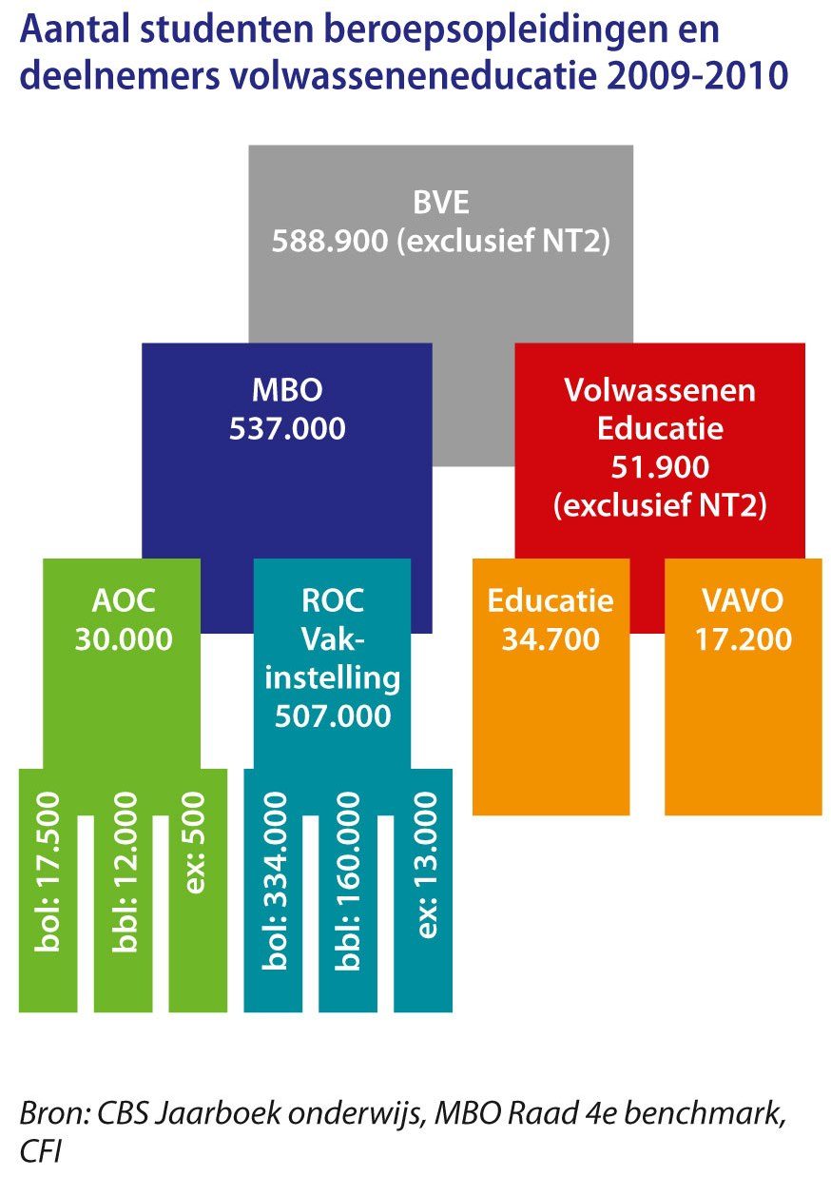

Slide 16
Participation in VET
Total: VET and Adult Education 588.900
VET
Full Time Students : 351.500
Parttime Students : 172.000
Other : 13.500
Adult education
Adult Education: 51.900
(Source: The Ministry of Oc&W (Education, Culture and Welfare) key figures 2009 2010

Slide 17
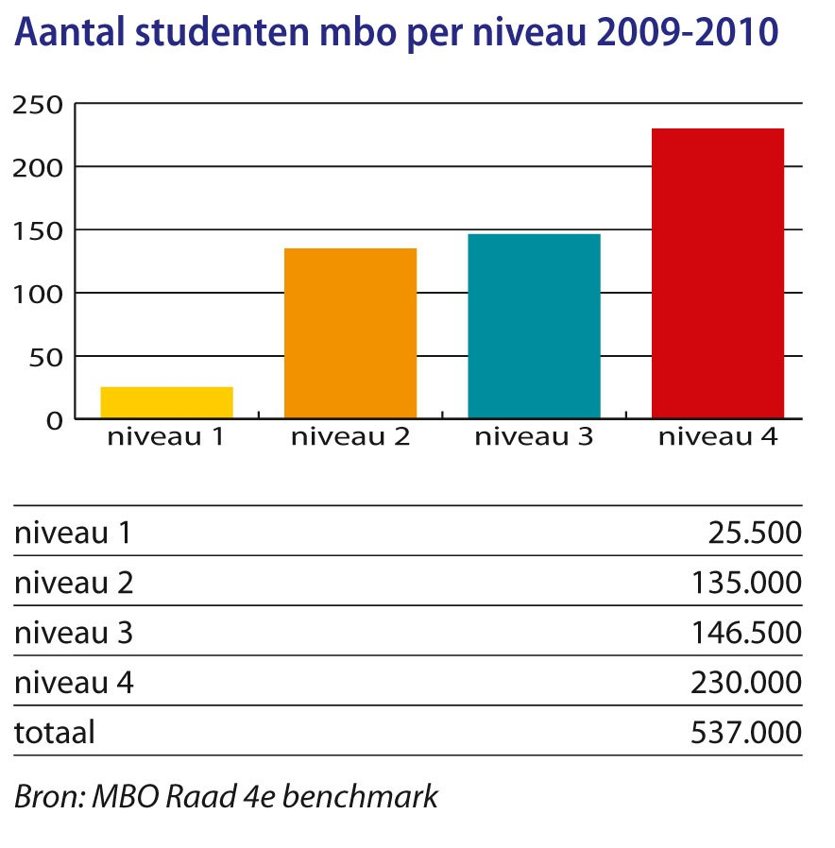
Participation in VET levels

Slide 18
Male-Female participation
Notes:
For years, the male-female ratio in vocational education and training has shown an imbalance in the sectors engineering & technology and health and social care. This imbalance is slowly improved upon. Five years previously, participation by men in health and social care was 10 percent, and participation by women in engineering & technology was also 10 percent.
(Source: Ministry of OC&W (Ministry of Education, Culture and Sciences) key figures2007)

Slide 19
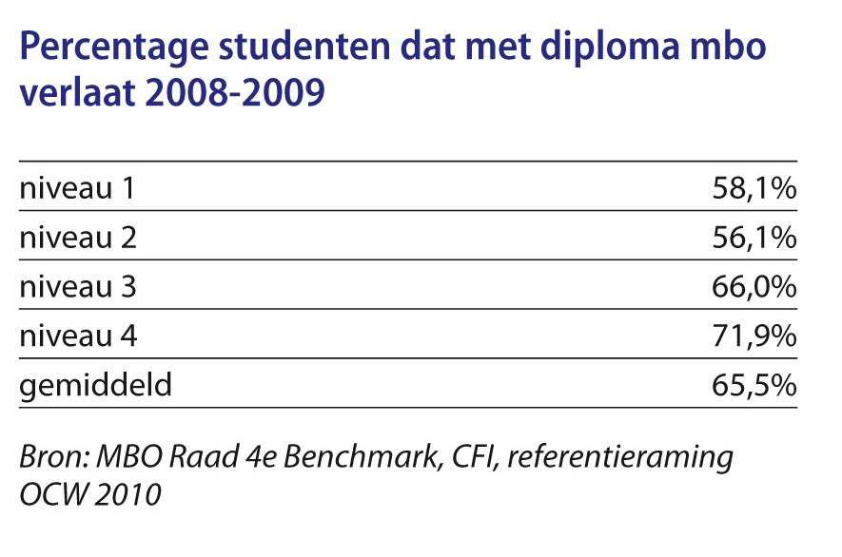
Educational output
Level 1 = 58 %
Level 2 = 56 %
Level 3 = 66 %
Level 4 = 72%
Notes:
In the Netherlands, the Ministry of Education, Culture and Sciences (OC&W) spends more than 30 billion Dutch guilders a year, on education. This represents 17% of all gross government expenditure, and 5.1% of the Gross Domestic Product. At 5.1% of GDP the Netherlands is below the OECD average of 6 percent.
More than 4 billion guilders from the OC&W budget are spent on the VET sector (vocational education and training and adult education). For each participant in vocational education, every VET institution receives 8,300 guilders for education and 900 guilders for accommodation. For adult education, OC&W provides 34 guilders per adult resident to the municipalities, in addition to 6,900 guilders per immigrant eligible for naturalisation into Dutch society, via an educational programme.
(Figures for 1997; excluding agricultural education; source: OC&W key figures 1999)

Slide 20
Finance
Education in the Netherlands
5,6 of Gross Domestic Product
Notes:
In the Netherlands, the Ministry of Education, Culture and Sciences (OC&W) spends more than 30 billion Dutch guilders a year, on education. This represents 5.6% of the Gross Domestic Product. At 5.1% of GDP the Netherlands is below the OECD average of 6 percent.

